Slide 1
AI skills to build the future Connect, code, and grow with Microsoft Learn training and resources
AI Expert Meet Up
Station #13
Notes:
Welcome to the AI Expert Meet Up Station! Here, we emphasize the importance of AI skills in shaping the future. Microsoft Learn offers a wealth of training resources designed to help you connect, code, and grow your expertise in AI. This is a fantastic opportunity to engage with fellow learners and experts, so we hope you take advantage of the resources available to you today. ______

Slide 2
Level up your AI skills with a challenge
Sharpen your skills with cutting-edge AI topics and enter the sweepstakes to win a free Certification exam.
Available until May 28th.
Notes:
We have a set of AI skills challenges designed to help you sharpen your AI skills with the latest topics in the field. By participating, you not only enhance your knowledge but also have the chance to enter a sweepstakes for a free Certification exam. Remember, this opportunity is available until May 28th, so make sure to take part and elevate your expertise. ______

Slide 3
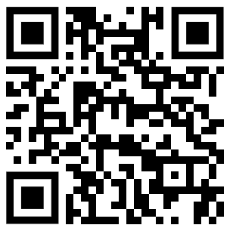
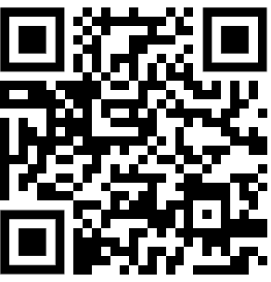
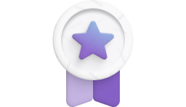
Azure AI Skills Fest Challenges
Create agentic AI solutions with Azure AI Foundry
Harness the latest cutting edge agentic AI technologies. Explore how to build and test AI-driven agents using Azure AI Foundry, develop an AI chat app, and orchestrate multi-agents using Semantic Kernel.
Architecture Recipes for AI-Powered Applications
Learn how to create and modernize applications, including modern database solutions, with essential Azure services including Azure AI Services, GitHub Copilot, and other critical services for intelligent application development.
Register now at
aka.ms/aiskillsfest/azureaifoundrychallenge
Register now at
aka.ms/aiskillsfest/azureaiserviceschallenge
Notes:
We have a variety of Azure AI challenges to choose from.
Sign up for the agentic AI Skills Fest Challenges as an exciting way to dive into learning the latest agentic AI solutions. You'll learn to harness cutting-edge technologies through Azure AI Foundry, developing skills to create AI-driven agents and applications. This is a unique opportunity to explore the latest advancements in AI and how they can be applied in real-world scenarios.
Register for the AI application challenge to develop an AI chat app and orchestrate multi-agents using Semantic Kernel. Additionally, in this challenge you’ll learn how to create and modernize applications with essential Azure services, including Azure AI Services and GitHub Copilot. ______

Slide 4
Copilot AI Skills Fest Challenges
Extend Microsoft 365 Copilot Chat and Microsoft Teams with agents and apps
Unlock the potential of Microsoft 365 Teams and Copilot by extending their capabilities with custom apps and agents. This challenge guides you through essential modules to explore, manage, and enhance Teams, creating seamless workflows and boosting productivity.
Treasure Hunt for AI Skills
Get ready to embark on an exciting treasure hunt into the world of AI, where you’ll uncover how it can simplify your everyday tasks. You’ll learn to craft effective prompts and discover how to analyze and build on AI-generated results.
Register now at
aka.ms/aiskillsfest/teamscopilotchallenge
Register now at aka.ms/aiskillsfest/businessaudiencechallenge
Notes:
We also have a variety of Copilot challenges you can register for.
Unlock the potential of Microsoft 365 Copilot and Teams by extending their functionalities with custom apps and agents. This challenge will guide you through essential modules that enhance productivity and streamline workflows.
Additionally, the treasure hunt for AI skills challenge will make learning engaging as you discover how AI can simplify your daily tasks. ______

Slide 5
Security AI Skills Fest Challenge
Prevent and respond to cyberattacks at the speed of AI
Learn how to safeguard your organization against modern risks with a streamlined SecOps platform supercharged by Microsoft AI and threat intelligence. Explore how Security Copilot and Defender XDR work together to increase productivity.
Register now at
aka.ms/aiskillsfest/securitycopilotchallenge
Notes:
We have a challenge that helps you safeguard your organization against cyber threats which is crucial in today's digital landscape. This challenge focuses on leveraging Microsoft AI and threat intelligence to enhance your security operations. By exploring tools like Security Copilot and Defender XDR, you'll learn how to respond to cyberattacks effectively and improve your organization's resilience. ______

Slide 6
Take your learning to the next level with Plans on Learn
A curated set of training content with milestones and optional email nudges designed to efficiently lead a learner to specific learning outcomes.
Notes:
Take your learning to the next level with curated training plans on Microsoft Learn. These plans are designed to guide you through specific learning outcomes with milestones and optional email nudges, ensuring you stay on track. This structured approach helps you efficiently acquire the skills needed to excel in your AI journey. ______

Slide 7
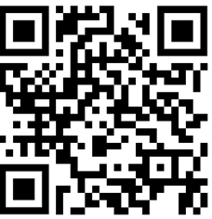
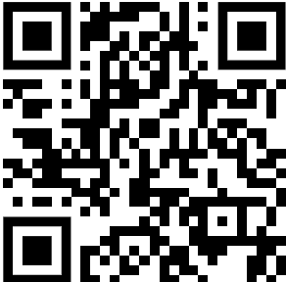
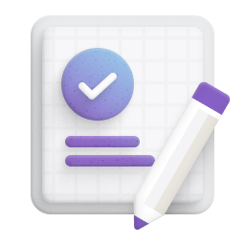

Explore our Azure AI agents skilling resources
Aligned to:
BRK141, BRK142, BRK149, BRK150, BRK155, BRK171, BRK280, DEM528, DEM529, DEM534, DEM592, DEM593, LAB325, LAB329, LAB335
Create agentic AI solutions by using Azure AI Foundry
This plan is designed to empower you to build and integrate AI-driven agents seamlessly into your applications and learn advanced model fine-tuning techniques.
Learn Live: Master the Skills to Create AI Agents
This series is designed to help you complete the official Microsoft Plan on Learn for mastering the latest agentic AI technologies.
Get started learning at
aka.ms/CreateAgenticAISolutions
Check out the videos at
aka.ms/AIAgentsLL/Reactor
Notes:
Explore our skilling resources to create agentic AI solutions using Azure AI Foundry. This plan empowers you to seamlessly integrate AI-driven agents into your applications while mastering advanced model fine-tuning techniques. Additionally, the 'Learn Live' series will help you complete the official Microsoft Plan on Learn, ensuring you stay ahead in AI technologies. ______

Slide 8
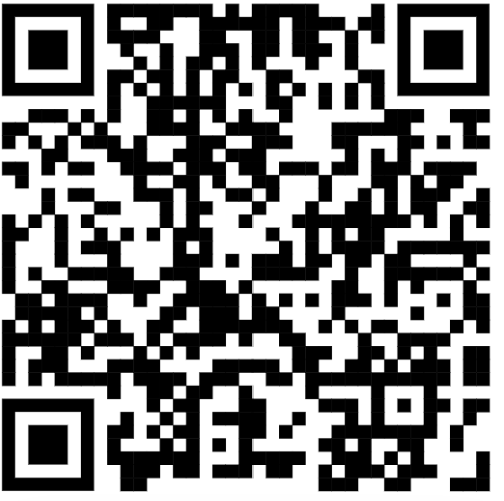
Explore our Azure AI agents skilling resources
Aligned to:
BRK145, BRK148, BRK152, BRK154, BRK162, LAB321, LAB333
A Developer's Guide to Azure AI Foundry, Apps, and Data
Discover strategies for organizing and managing data pipelines, structuring application logic, and leveraging the latest AI models in a holistic, developer-focused way
Start learning at
aka.ms/ai_agents_apps__data
Notes:
The Developer's Guide to Azure AI Foundry, Apps, and Data is a valuable skilling resource for developers looking to enhance their skills. It provides strategies for managing data pipelines and structuring application logic while leveraging the latest AI models. This holistic approach ensures that you can effectively integrate AI into your development processes, maximizing your productivity and innovation. ______

Slide 9
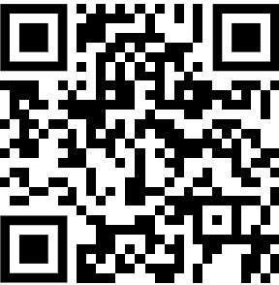
Explore our Azure AI skilling resources
Aligned to:
BRK144, BRK146, BRK153, BRK172, BRK173, BRK174, BRK178, DEM524, DEM530, DEM531, DEM585, DEM586, DEM587, DEM591, LAB324
Find the best model for your generative AI solution with Azure AI Foundry
This plan will help you get started learning how to enable multimodal models, make model selections, work with benchmarking tools, create multimodal applications, and unlock the potential of generative AI.
Begin learning at
aka.ms/BestModelGenAISolution
Notes:
Finding the right model for your generative AI solution is essential. This plan will guide you through enabling multimodal models, making informed model selections, and utilizing benchmarking tools. By learning to create multimodal applications, you'll unlock the full potential of generative AI and enhance your development capabilities. ______

Slide 10
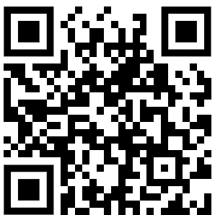
Explore our Azure AI apps skilling resources
Aligned to:
BRK143, BRK170, DEM526
Build AI apps with Azure Services and best practices
Learn how to design and build a cloud-native AI app, develop a back-end database, and integrate Azure AI services into applications.
Start learning at
aka.ms/ADAI_DevStartPlan
Notes:
Building AI applications with Azure Services requires understanding best practices. This plan will teach you how to design and develop cloud-native AI apps, including back-end database integration and the use of Azure AI services. By mastering these skills, you'll be well-equipped to create innovative solutions that leverage the power of AI. ______

Slide 11
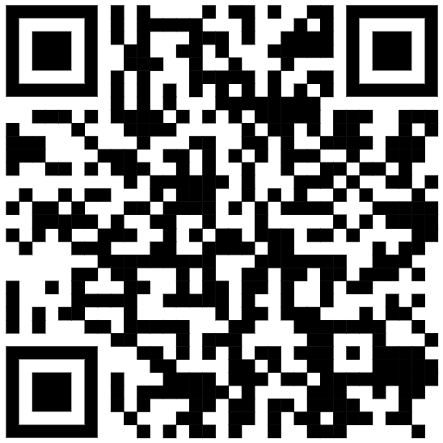
Explore our Azure AI apps skilling resources
Aligned to:
DEM522, LAB334
Develop, replatform, and improve AI apps via advanced Azure AI services
Learn how to build and modernize AI apps, specifically in replatforming apps and assessing code and architecture changes on Azure
Begin learning at
aka.ms/ADAI_DevsAdvPlan
Notes:
Modernizing AI applications is essential for staying competitive. This skilling plan focuses on developing and replatforming AI apps using advanced Azure AI services. You'll learn how to assess code and architecture changes, ensuring your applications are optimized for performance and scalability in the cloud environment. ______

Slide 12
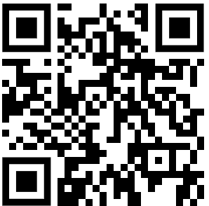
Explore our responsible AI skilling resources
Aligned to:
BRK168, BRK169, DEM527
Build secure and responsible AI solutions and manage generative AI lifecycles
This plan will help you understand the fundamentals of AI security, evaluate generative AI outputs, and manage harmful content using Azure AI Content Safety.
Get started learning at
aka.ms/ManageGenAILifecycles
Notes:
As AI continues to evolve, building secure and responsible AI solutions is paramount. This plan will help you grasp the fundamentals of AI security, evaluate generative AI outputs, and manage harmful content effectively. Understanding these principles is crucial for developing trustworthy AI applications that adhere to ethical standards. ______

Slide 13
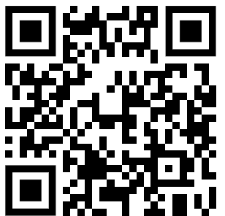
Explore our AI transformation skilling resources
Aligned to:
BRK141
Start transforming your business with AI
This plan provides a comprehensive guide on AI transformation, including initiating an AI strategy, assessing infrastructure readiness, understanding AI's business impact, and creating intelligent apps using Azure AI service
Begin learning at
aka.ms/StartTransformingBizAI
Notes:
If you’re a business decision maker, transforming your business with AI starts with a solid strategy. This comprehensive guide will walk you through initiating an AI strategy, assessing your infrastructure readiness, and understanding the business impact of AI. By creating intelligent applications using Azure AI services, you can drive significant improvements in your organization. ______

Slide 14
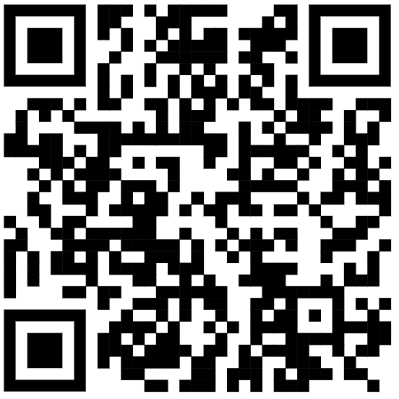
Explore our Copilot skilling resources
Aligned to:
BRK140, BRK147, BRK157, BRK158, BRK159, BRK160, BRK161, DEM521, LAB322, LAB327, LAB332
Build & extend copilots with Microsoft Copilot Studio
This plan is designed to help you to get started creating conversational AI solutions with Microsoft Copilot Studio. Learn how to build Copilot Studio actions that extend the knowledge and capabilities of Microsoft 365 Copilot.
Start learning at
aka.ms/BA_BldandExdCop
Notes:
Microsoft Copilot Studio offers exciting opportunities to build and extend conversational AI solutions. This plan will help you get started with creating actions that enhance the capabilities of Microsoft 365 Copilot. By learning to leverage Copilot Studio, you can develop innovative solutions that improve user experiences and productivity. ______

Slide 15
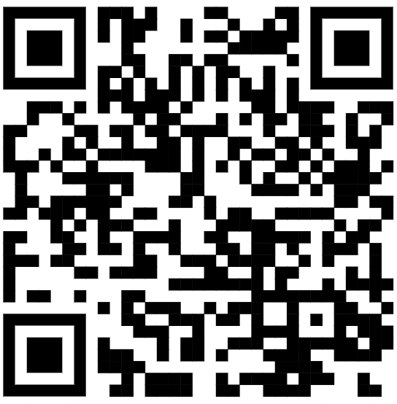
Explore our Copilot skilling resources
Aligned to:
BRK156, BRK163, BRK164, BRK165, BRK16, BRK167, BRK176, BRK177, LAB323, LAB328, LAB330
Extend Microsoft 365 Copilot
Explore how to use Copilot Studio actions to extend the knowledge and capabilities of Microsoft 365 Copilot. Discover the different ways to extend Microsoft 365 Copilot, including building plugins and connectors, and learn how to choose the right option for your use case.
Start learning at
aka.ms/MW_M365CoPDev
Notes:
Extending Microsoft 365 Copilot's capabilities is key to maximizing its potential. This skilling plan outlines various ways to use Copilot Studio actions, including building plugins and connectors. Understanding how to choose the right extension option for your use case will empower you to create tailored solutions that meet specific business needs. ______

Slide 16
Prove your skills with Microsoft Credentials
Showcase your proficiency with industry-trusted and verified credentials from Microsoft
Notes:
Welcome to the section on proving your skills with Microsoft Credentials. In this slide, we will discuss how you can showcase your proficiency with industry-trusted and verified credentials from Microsoft. These credentials are designed to validate your skills and knowledge in Microsoft AI, providing you with a competitive edge in the job market. By earning these credentials, you demonstrate your expertise and commitment to continuous learning and professional development. Let's explore the various credentials available and how they can benefit your career

Slide 17
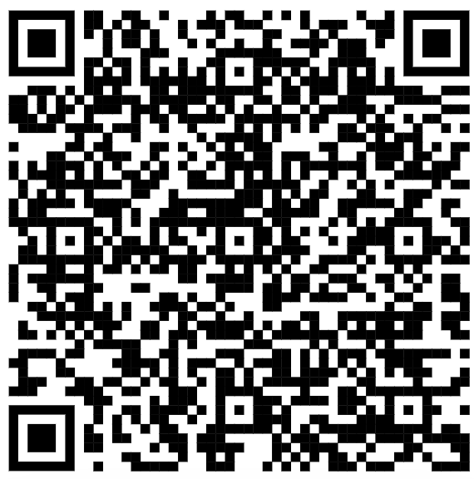
Earn Microsoft AI Credentials
Certifications
Applied Skills
Industry-recognized credentials aligned to job roles that validate your skills and knowledge in Microsoft AI
Scenario-based credential that proves your proficiency in skill sets specific to critical business problems
Azure AI Fundamentals
Build a natural language processing solution with Azure AI Language
Build An Azure AI Vision Solution
AI-900
Azure AI Engineer Associate
Create an intelligent document processing solution with Azure AI Document Intelligence
Develop AI agents using Microsoft Azure OpenAI and Semantic Kernel
AI-102
Azure Data Scientist
Implement AI models with Microsoft Power Platform AI Builder
Train and manage a machine learning model with Azure Machine Learning
DP-100
aka.ms/CredentialsForAI
Notes:
Let’s dive deeper into scenario-based credentials that prove your proficiency in skill sets specific to critical business problems.
These industry-recognized credentials are aligned to job roles and validate your skills and knowledge in Microsoft AI. By earning these credentials, you can showcase your ability to tackle real-world challenges and contribute to your organization's success.
Key role-based certifications such as Azure AI Fundamentals, Azure AI Engineer Associate, and Azure Data Scientist, are crucial for anyone aiming to excel in the AI field.
Additionally, the applied skills section emphasizes practical proficiencies, including natural language processing and intelligent document processing, which are vital for addressing real-world business challenges.
Check out our credential offerings take a closer look at how these credentials can help you advance your career in AI.
______

Slide 18
Explore our Learning Hubs
Your trusted source to help you learn AI skills and get ready to power AI transformation with the Microsoft Cloud.
Notes:
Our Learning Hubs serve as your trusted source for acquiring AI skills. They are designed to prepare you for powering AI transformation with the Microsoft Cloud. By utilizing these resources, you can enhance your knowledge and skills, positioning yourself as a leader in the AI space. ______

Slide 19
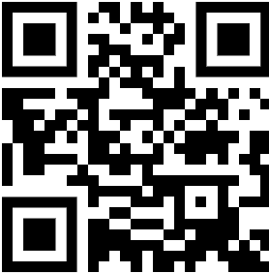
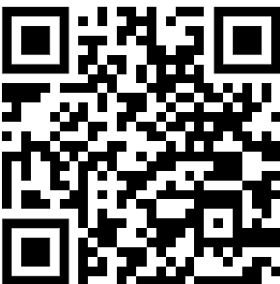


Begin your AI learning journey
AI learning hub
Explore resources to support business and technical roles, individuals, and organizations in their learning journey for all Microsoft’s AI apps and services.
Copilot learning hub
Discover training, documentation, and videos as you gain new skills to deepen your technical expertise in Microsoft Copilot.
learn.microsoft.com/ai
learn.microsoft.com/copilot
Notes:
If you still don’t know where to start, or in case you get stuck along the way, you can stay on track of your AI learning journey with our dedicated hubs. The AI learning hub offers resources tailored for business and technical roles, while the Copilot learning hub provides training and documentation to deepen your expertise in Microsoft Copilot. These resources are invaluable for anyone looking to excel in AI applications and services. ______

Slide 20
Discover Microsoft Learn at Build
Your trusted source to help you learn AI skills and get ready to power AI transformation with the Microsoft Cloud.
Notes:
At Microsoft Build, we invite you to discover the full range of activities and learning opportunities available. Microsoft Learn is your gateway to enhancing your skills and knowledge, providing a structured approach to learning that aligns with the latest industry trends and technologies. Make sure to explore all the sessions and workshops tailored for your growth. ______

Slide 21
Explore Microsoft Learn On-Demand at Build
In-person Learning at Microsoft Build
Join us on Level 3 to take the Microsoft Build Challenge in-person, find more labs, earn a Microsoft credential, or even complete a practice assessment.
Notes:
Join us in the Microsoft Learn on-demand area located at 800 Pike on level three where you can explore on-demand learning including joining the in-person Microsoft Build Challenge, participating in on-demand labs, and earning a Microsoft credential.
The in-person Microsoft Build challenge is especially a great chance to get a prize by challenging your knowledge and skills while gaining practical experience in a collaborative environment. It will be open during all event hours Monday – Thursday, and will have proctors available to support and answer questions.
Additionally, you can benefit from a 100% discount for one exam onsite available for both Microsoft Certification and GitHub Certification. Onsite certification testing hour are:
Mon, 5/19 from 1-7:30PM
Tue, 5/20 from 10:30am-6PM
Wed, 5/21 from 9AM-6PM
Thu, 5/22 from 8:30AM-12:30PM
The Learn On-demand area will also have self-serve machines with access to:
Microsoft Applied Skills
Practice assessments
Make sure to take advantage of these opportunities to further your learning journey and achieve your goals. We hope you enjoy the rest of Build and please come back if you have any additional AI skilling questions ______

Slide 23


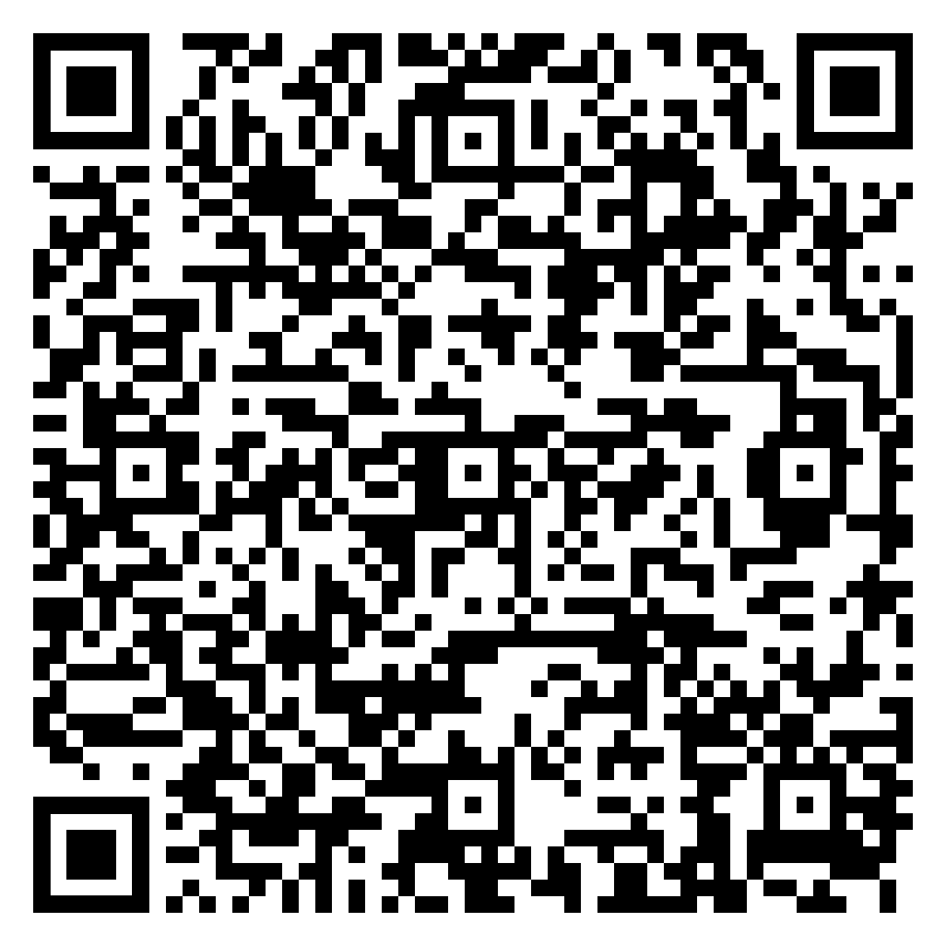
Azure AI Foundry
Leave a product review, get $25!
Share your insights using Azure AI Foundry. Help other developers and become a thought leader.
Choose a $25 gift card as a “thank you” for your time.
Any technical roles, from VPs to developers, can leave a review. Must be a real customer of Azure AI Foundry.
https://aka.ms/leaveareview

